Slide 1

‘To Take Or Not To Take’
Note Taking
The primary purpose of note taking is to encourage active learning and to prepare study materials for exams.
Developing note taking skills should help you organize information into an understandable format that will assist in your studying process.
www.dcu.ie/studentlearning

Slide 2
Taking notes
There are two main reasons why note-taking is important:
When you are reading or listening, taking notes helps you to concentrate on something sensible.
taking notes help you make sense of the text
Taking notes does not mean writing down every word you hear; you need to actively decide what is important and how is related to what you have already written.

Slide 3
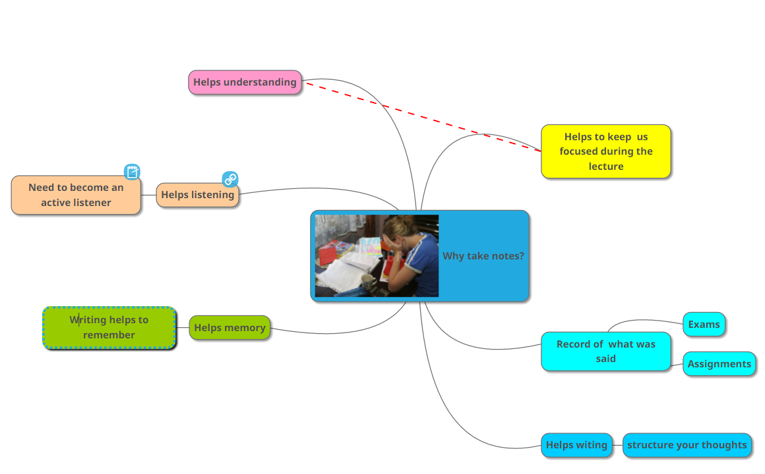
Why take notes?

Slide 4

1. Why take notes?
Turn to the person next to you
Why should you take notes?
What difficulties do you experience in taking notes?
Notes:
Take feedback from group, put onto flipchart

Slide 5
Types of Note Taking
Outline
Mapping
Paragraph form
Annotating
Cornell

Slide 6

Before the lecture – top 5 tips
Read previous lecture notes
Download & read new lecture notes from Loop.
Formulate questions to answer
Prepare your note-taking material e.g. use a separate notebook for each module.
Arrive 3-5 mins before the lecture.

Slide 7
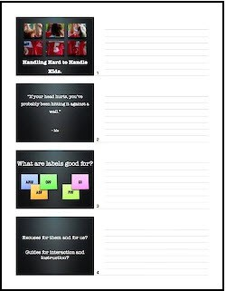
Annotating powerpoint
Highlight important slides
Add detail

Slide 8
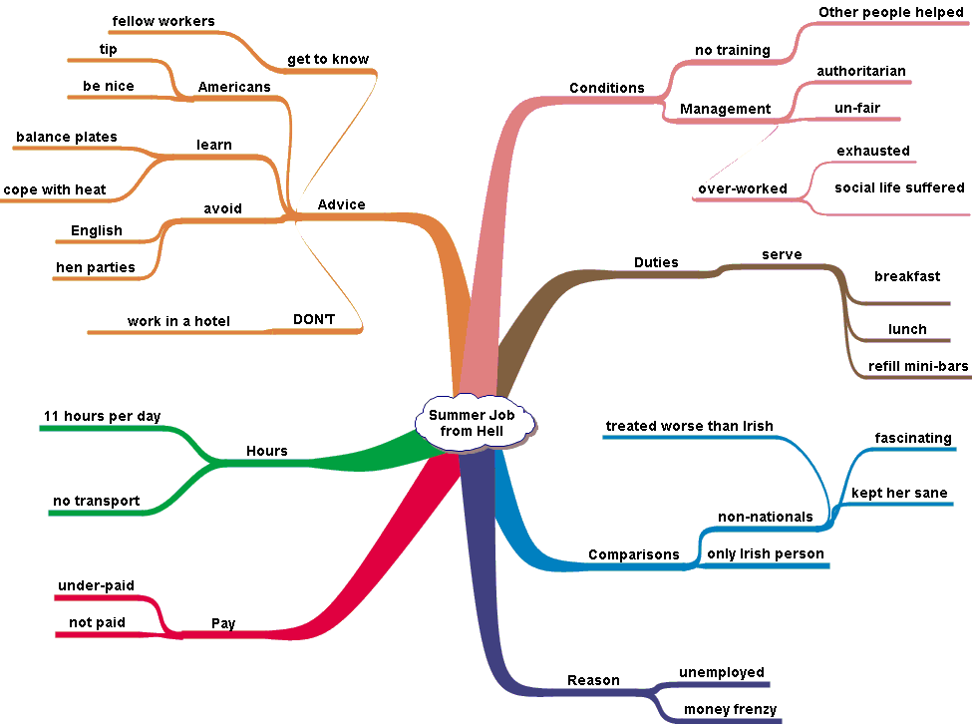
Mind map

Slide 9
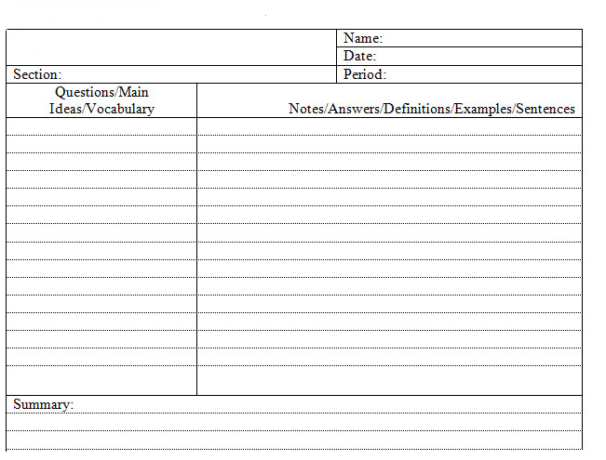

Cornell style
Dedicated notebook
Date, module etc listed
https://www.youtube.com/watch?v=WtW9IyE04OQ
Notes:
https://www.youtube.com/watch?v=WtW9IyE04OQ
Or https://www.youtube.com/watch?v=Y4uzQEWj0X8

Slide 10
First, reading the headings given in the question will be the best course of action. It will tell you what information you need to find from the passage and copy into your answer

Slide 11
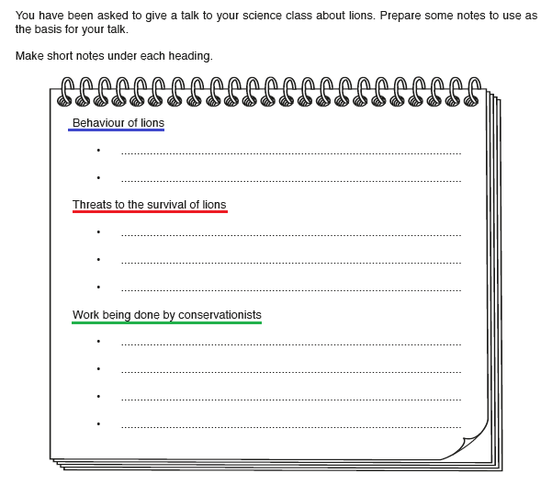

Slide 12
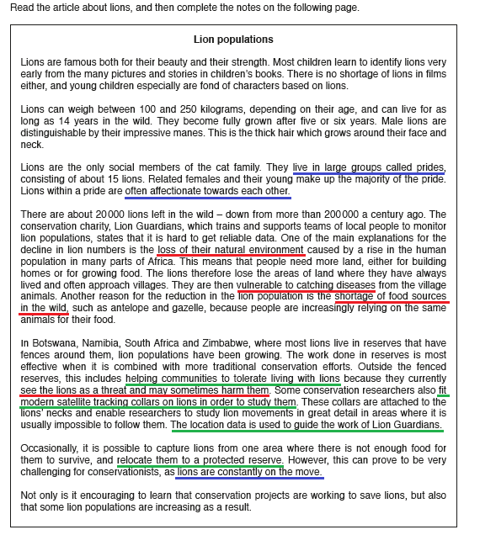

Slide 13
Abbreviations & Symbols
Only in notes, not assignments / exams
Abbreviations
experiment | expt
Education | ed
Curriculum | curr
Probably | prob
support | supp
exercise | exer
strategy | strat
Important | NB
Symbols
Increase / goes up / rises
Decrease / lowering
leads to, produces, causes, makes
comes from, is the result of

Slide 14

5. Consolidate your learning!
Cohen, Kim, Tan and Winkelmas (2013): students who completed a task requiring them to restructure their notes and submit a summary of them achieved on average 11 percentage points higher in the module examination
that’s one whole grade!!
Notes:
Whatever style you choose – be organised! Have an individual notebook for each module. Label each lecture clearly.

Slide 15

Helpful Hints
Need to take notes in a way that is meaningful to you
Develop a positive attitude towards lectures
Keep notes brief - phrases
Leave spaces
Make just ONE set of notes
Number pages
Use abbreviations, headings and colour

Slide 16
Note-Making
The first stage of note-making is to identify the key points in the text for your purpose. You are preparing to write an essay on ‘Changing patterns of longevity’.
Study the following example (key points in italics).

Slide 17
WHY WOMEN LIVE LONGER
Despite the overall increase in life expectancy in Britain over the past century, women still live significantly longer than men. In fact, in 1900 men could expect to live to 49 and women to 52, a difference of three years, while now the figures are 74 and 79, which shows that the gap has increased to five years.

Slide 18
WHY WOMEN LIVE LONGER
Despite the overall increase in life expectancy in Britain over the past century, women still live significantly longer than men. In fact, in 1900 men could expect to live to 49 and women to 52, a difference of three years, while now the figures are 74 and 79, which shows that the gap has increased to five years.

Slide 19
Various reasons have been suggested for this situation, such as the possibility that men may die earlier because they take more risks. But a team of British scientists have recently found a likely answer in the immune system, which protects the body from diseases. The thymus is the organ which produces the T cells which actually combat illnesses. Although both sexes suffer from deterioration of the thymus as they age, women appear to have more T cells in their bodies than men of the same age. It is this, the scientists believe, that gives women better protection from potentially fatal diseases such as influenza and pneumonia.

Slide 20
Various reasons have been suggested for this situation, such as the possibility that men may die earlier because they take more risks. But a team of British scientists have recently found a likely answer in the immune system, which protects the body from diseases. The thymus is the organ which produces the T cells which actually combat illnesses. Although both sexes suffer from deterioration of the thymus as they age, women appear to have more T cells in their bodies than men of the same age. It is this, the scientists believe, that gives women better protection from potentially fatal diseases such as influenza and pneumonia.

Slide 21
British women live longer than men: 79/ 74 years
reasons? new research suggests immune system/thymus >
T cells
women have more T cells than men = better protection

Slide 22

Unit 2.1
Finding Key Points
Academic & Professional Writing

Slide 23
Finding Key Points for your writing requires careful
reading in order to explore relevant information.
Some authors write the key points very clearly whereas others write it in between the lines.
Only practice can make you expert in finding key points from the text.

Slide 24
Following points can help you find the Key Points:
Identify the topic
Summarize the Passage
Look at the first and last sentences of the text
Look for repetition of ideas
Look for Thesis and topic sentences
Read the conclusion of the text

Slide 25
Exercise:
Read the following paragraph and underline the stated main idea. Write down in your own words what you are able to conclude from the information.
The rules of conduct during an examination are clear. No books, calculators or papers are allowed in the test room. Proctors will not allow anyone with such items to take
the test. Anyone caught cheating will be asked to leave the room. His or her test sheet will be taken. The incident will be reported to the proper authority. At the end of the
test period, all materials will be returned to the proctor. Failure to abide by these rules will result in a failing grade for this test.
Notes:
https://www.cuesta.edu/student/resources/ssc/study_guides/reading_comp/307_read_main_idea.html

Slide 26
Answer:
You should have underlined the first sentence in the paragraph – this is
the stated main idea.
Conclusion:
If you do not follow the rules, you will automatically fail the test. This
concluding information is found in the last sentence.

Slide 27
Exercise:
Try to locate the topic and the main idea.
Most teenagers and young adults do not know what they want to do for the rest
of their lives. It is a big decision. There are a number of things you can do to
narrow the choices. For example you can take an interest test, do some research on your own about a career, try volunteer work in the field in which you are
interested, or “job-shadow”, in which you spend a day with a person who is
working in a field that interests you. These are just a few helpful ideas as you begin to choose a career.
Notes:
https://www.landmarkoutreach.org/strategies/finding-main-idea/

Slide 28
Answer:
In this paragraph:
The topic is jobs or career choices
The main idea is a few ideas to help the reader choose a career

Slide 29
Practice Exercises:
Finding Key Points – Pg. 36 (Academic Writing by Stephen Bailey)
Finding Relevant Points – Pg. 37 (Academic Writing by Stephen Bailey)
Notes:
Bailey, S. (2015). Academic writing: A handbook for international students (4th ed.). Routledge.

Slide 30
Underline three key points in the following text.
EMPOWERING HEALTHCARE
In many parts of the world hospitals have none of the modern health equipment that is common in western countries. This is partly because it is expensive, but also because electricity supplies are often unreliable, while trained staff who can read the complex displays may not be available. Now, Freeplay Energy, the company which developed the wind-up radio, is planning to introduce a range of medical equipment which can be used in those areas. All the machines will be of simple, robust design which will either use solar power or foot pedals, making
expensive battery replacement unnecessary. Prototypes are currently on trial in South African hospitals, where their performance can be compared with more sophisticated machines.

Slide 33
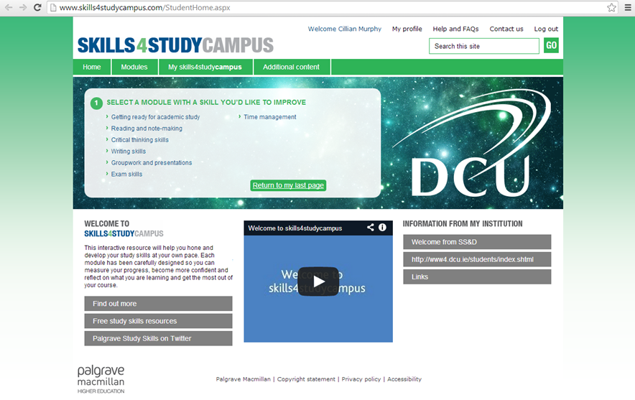
Further resources
Notes:
Link to youtube video:
http://www.youtube.com/watch?v=DGUmF77Puoc

Slide 34
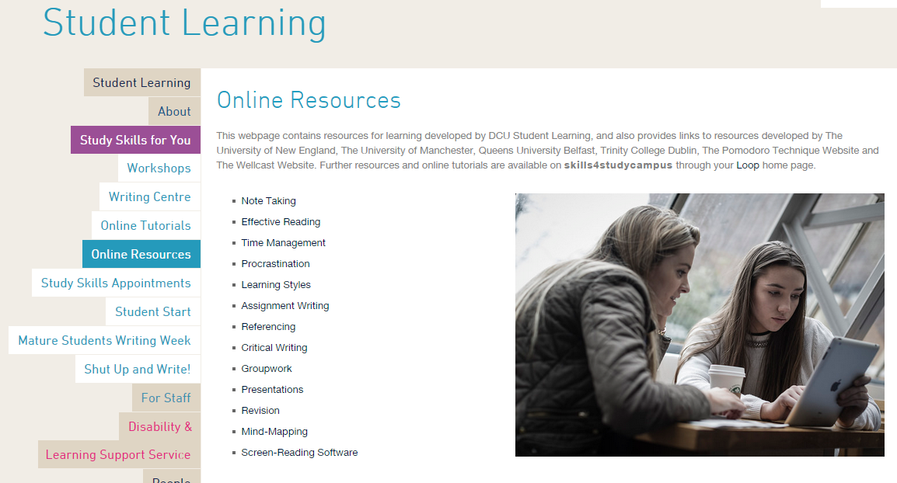
Access these slides on our website

Slide 35

Summary
Before
During
After

Slide 36
References
Cohen, D., Kim, E., Tan, J. & Winkelmes, M. (2013) A note-restructuring intervention increases students’ exam scores. College Teaching , 61(3), pp. 95-99.
Desrochers, J. 2012. How to take Cornell notes [Online]. Available from: https://www.youtube.com/watch?v=WtW9IyE04OQ [Accessed 28 August 2014].
Skills4Study Campus 2014. Reading and note-making [Online]. Available from: http://www.skills4studycampus.com/StudentHome.aspx [Accessed 28 August 2014].

